Slide 1
ENGI 301 Ready, Set, Candy! PCB Project
12/12/2023
Sunny Yu

Slide 2
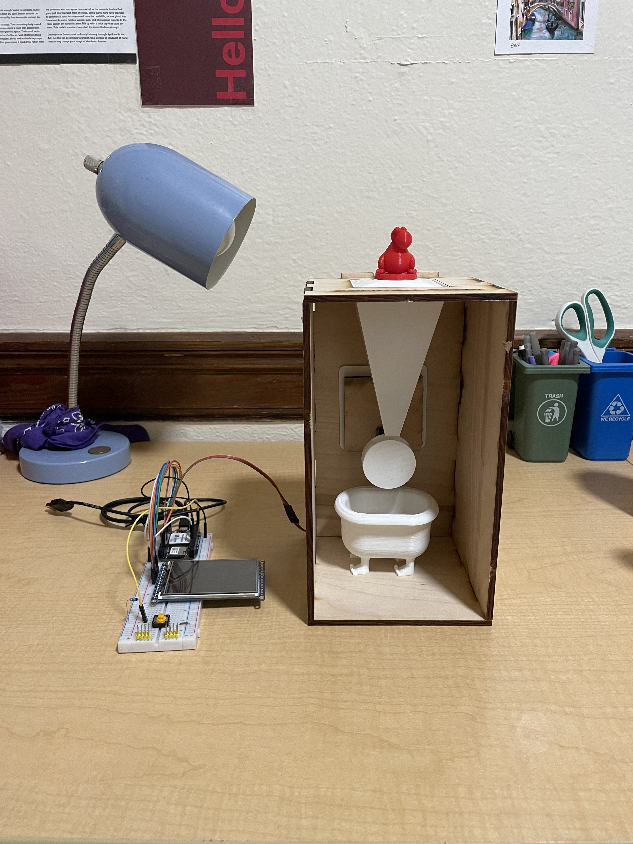

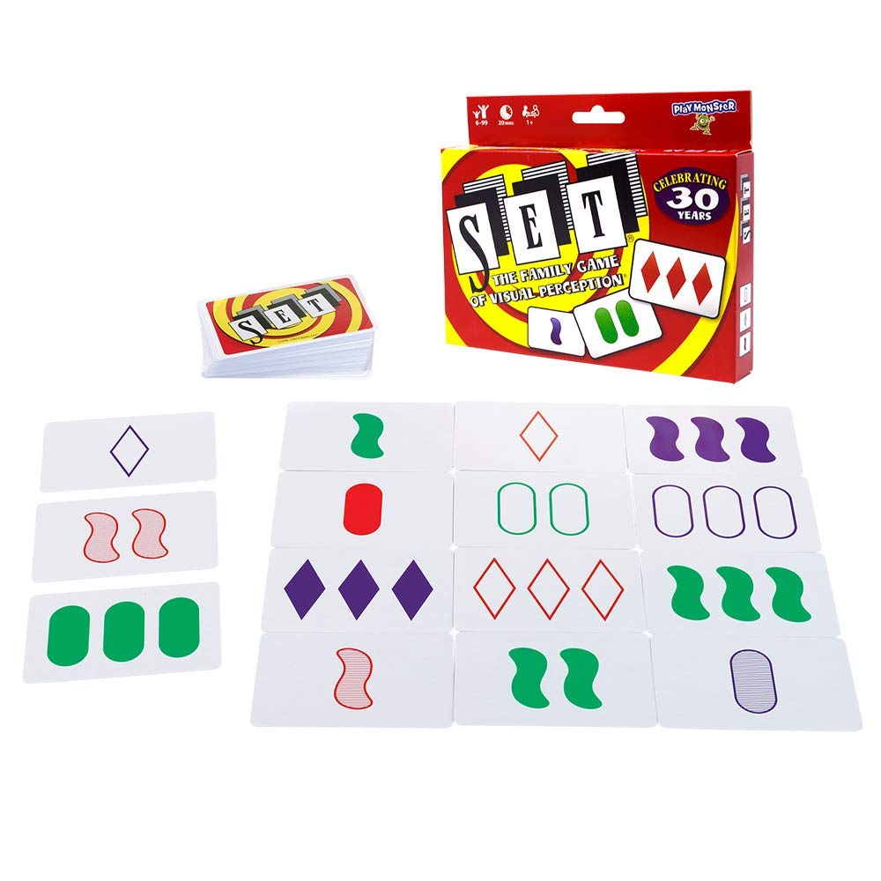
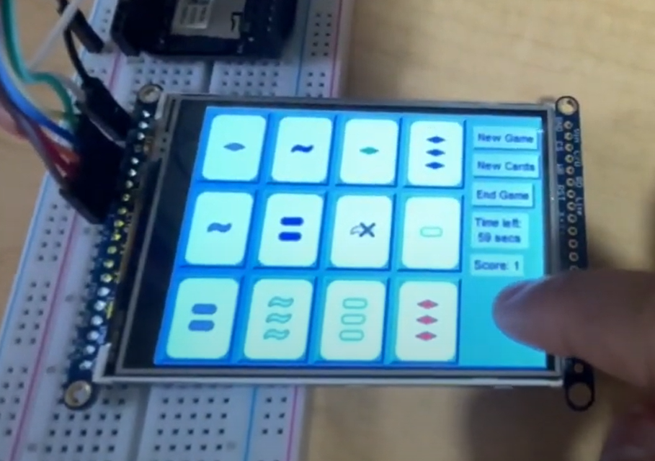
Background Information
Create a PCB for “Ready, Set, Nerds!”
A system designed to dispense candy (Nerds) after beating a game of Set
Helps limit the time spent playing games and the amount of candy consumed
Hardware:
SPI Display Screen
One Button (Dispense candy)
One Continuous Servo Motor

Slide 3
System Block Diagram – Ready, Set, Nerds!
PocketBeagle
3.3V
VCC
Servo
PWM
GND
3.3V
SPI
SPI
SPI Display
SPI
VCC
1k
GPIO
Button
GPIO
GPIO
GPIO
GND

Slide 4
Mechanical Drawing – Ready, Set, Nerds!
101 mm
Pocket Beagle
Servo
127 mm
SPI Display Screen
(85 mm x 56 mm)
Button
BOARD
DISPENSER

